Slide 1
When “Shit Happens”
NTUEE Present

Slide 2
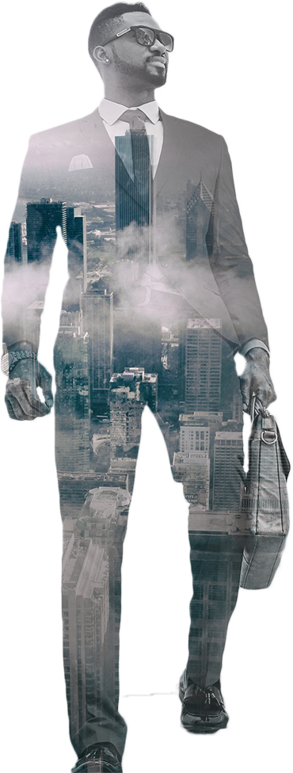
outline
01
Motivation
02
Design
03
Demo
04
Future work

Slide 3
Motivation

Slide 4
Motivation
We are tired of toilet mess in our dormitory.
Somebody may shit around and won’t clean it up because he
is “lazy”.
We think the original intention of lazy technology is to bring convenience to our life without bothering others.
This device is used to raise people’s awareness of empathy.

Slide 5
Design

Slide 6
Design
Face recognition & registration
Wireless communication
Use Azure service as image container
Computer vision for edge detection

Slide 7
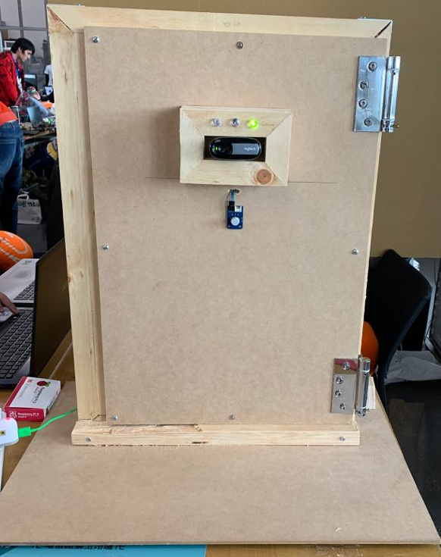
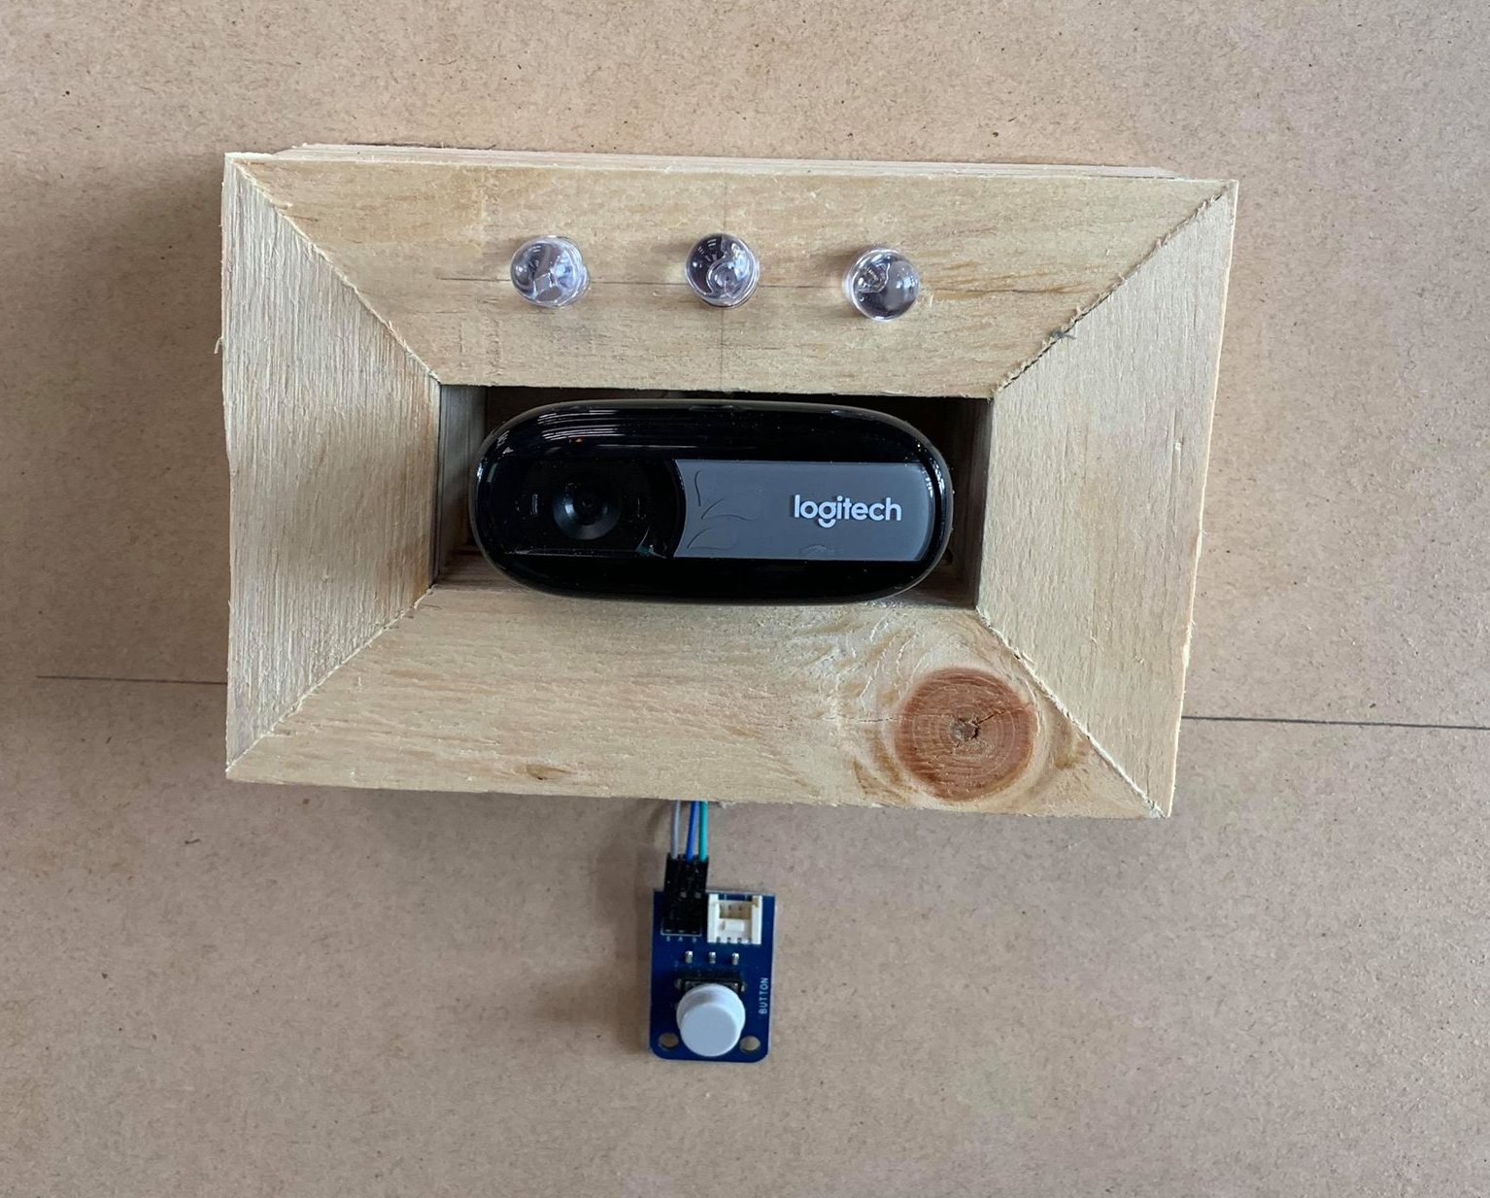
Device-front
Webcam:
Face recognition
LED:
different color for different signal
Enter bottom

Slide 8
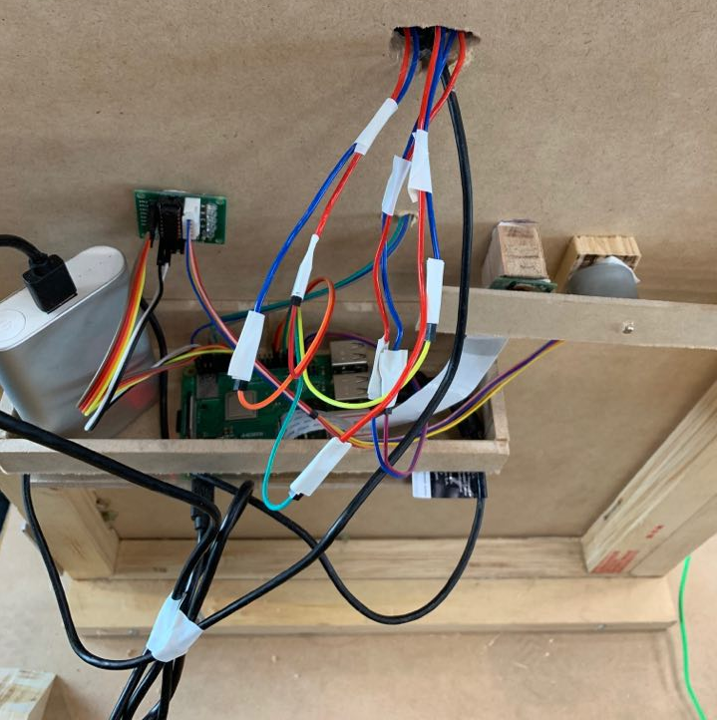
Device-back
Pi Camera
Stepper motor:
Locker
Rpi

Slide 9
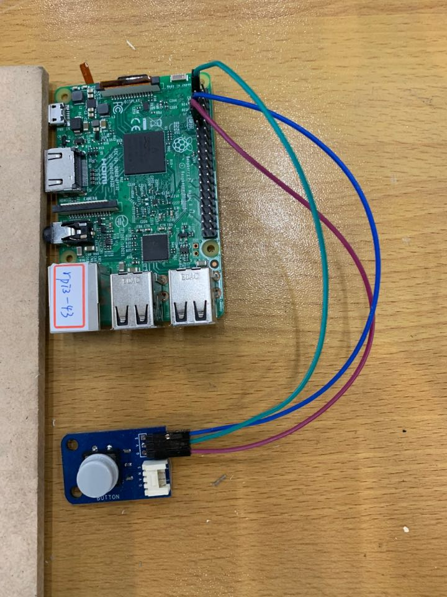
Device-flusher

Slide 10
Demo

Slide 11
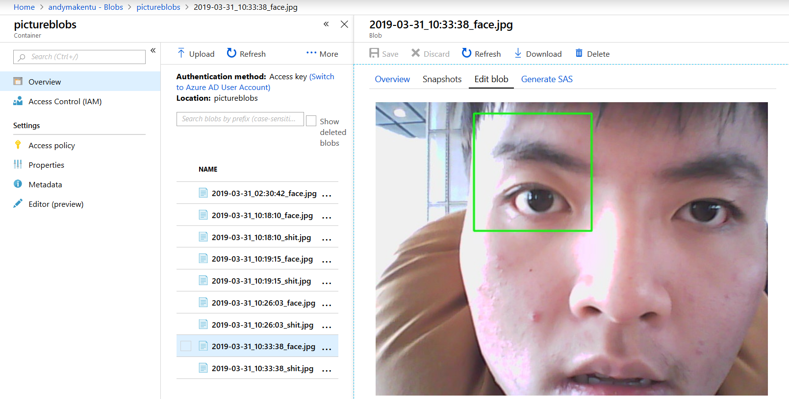
Azure image container

Slide 12
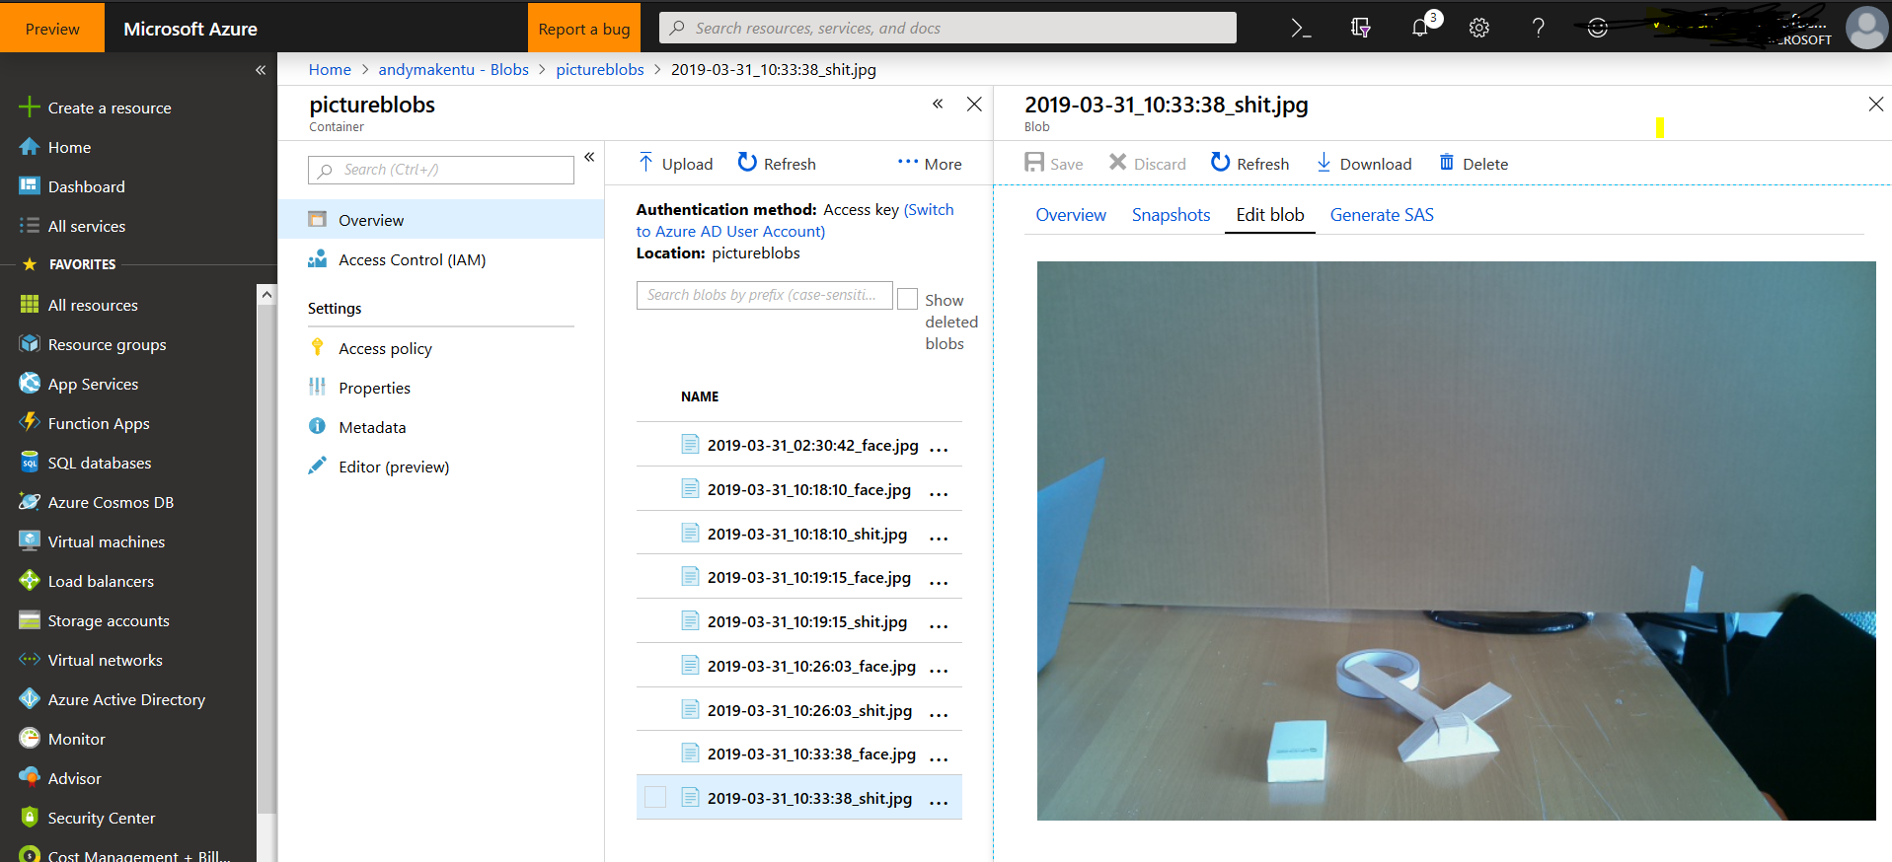
Azure image container

Slide 13
Future work

Slide 14
Future work
Automatically send an email to shitter and give him/her warning.
Make device smaller.
Pi camera has limited vision, can’t capture all the corner.
Due to computing ability of Rpi, the detection is quite slow and unstable.
We can make the detection more powerful in the future.

